Slide 1


Introduction to Eclipse, RobotBuilder and FRCSIM
Dave Frederick, Mentor
Team 1895, Manassas, VA
December 3, 2016 Version 1.0

Slide 2

Goal of Workshop
Demonstrate a process to create a basic Robot using Eclipse and RobotBuilder
Demonstrate the FRCSIM (Robot Simulator)
WPI (Worcester Polytechnic Institute) Robot Builder Resource:
https://wpilib.screenstepslive.com/s/4485/m/26402

Slide 3
Process to Build Robot Software - Overview
Design the Robot on Paper
Build Robot in RobotBuilder
Create subsystems, commands and Operator Interface
Import RobotBuilder into Eclipse
Finish the Software in Eclipse
Create methods within the subsystems to implement commands
Deploy, Test, Troubleshoot
Expand, Revise, Enhance

Slide 4
Step 1: Design the Robot
Understand the Game then Design the Robot
Define the Requirements for the Robot
Understand how to play the Game and scoring
Decide how your Team will play the game
Decide what your robot needs to do
Create an initial design of the Robot and decompose into Subsystems
Identify Subsystems: Drive Train, Shooter/Manipulator
Design the User Interface: Joystick control functions, Smart Dashboard
Identify what the robot will do: autonomous actions, drive behavior, arm movements
Software High Level Design
Determine what functions/actions the subsystems must do. Document requirements
Determine the best approach for the User Interface, How do you drive the robot?

Slide 5
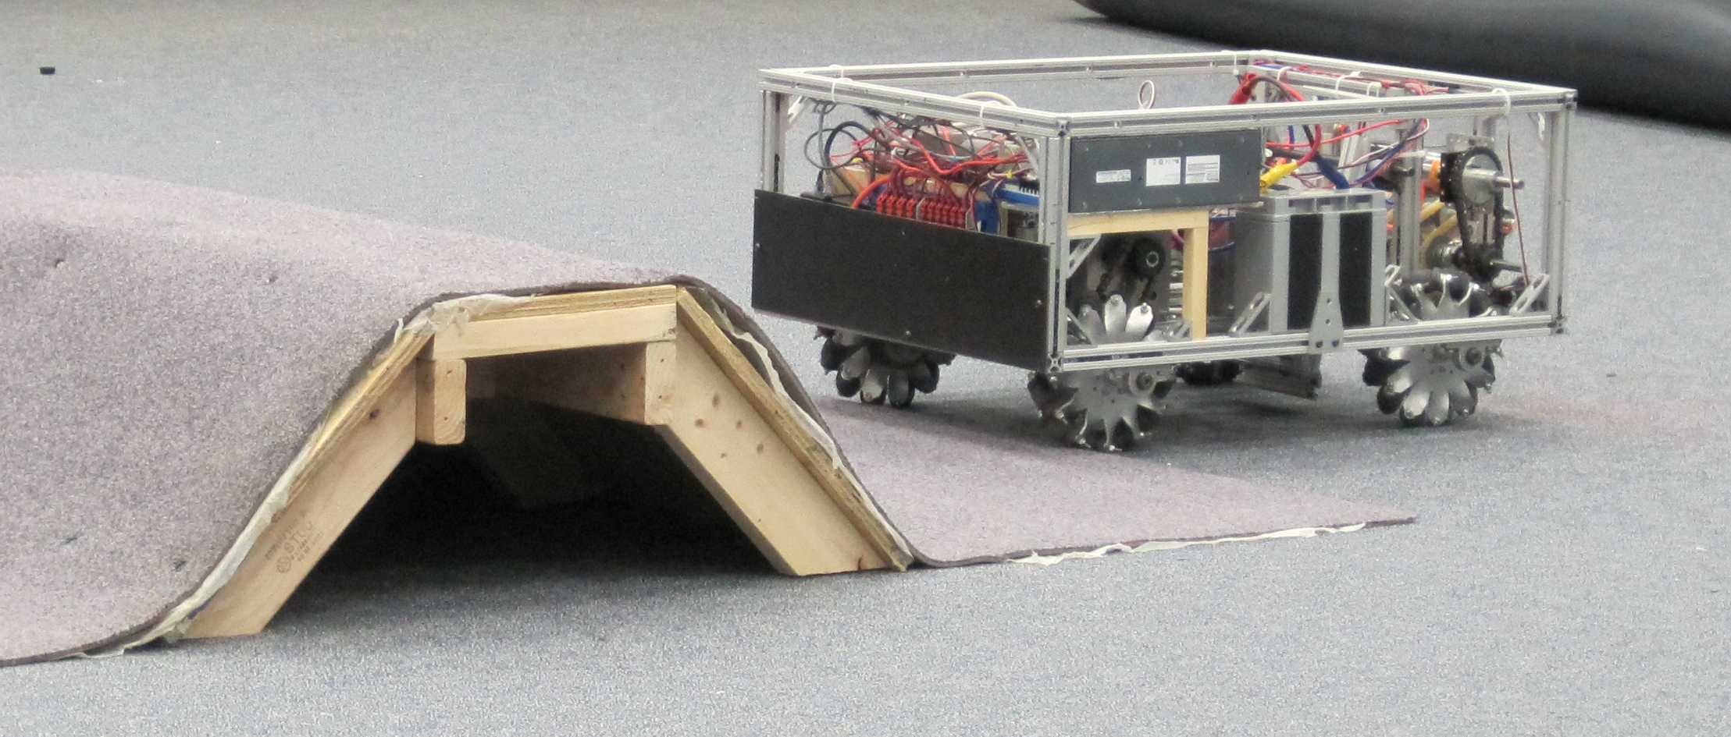
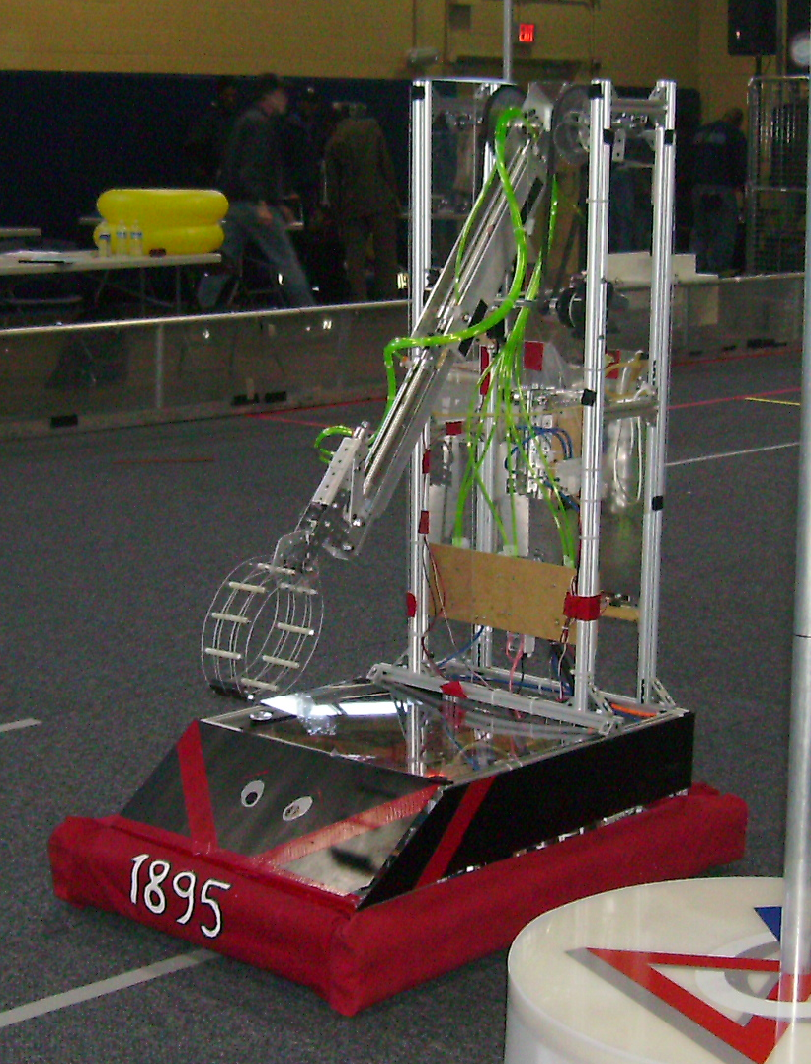
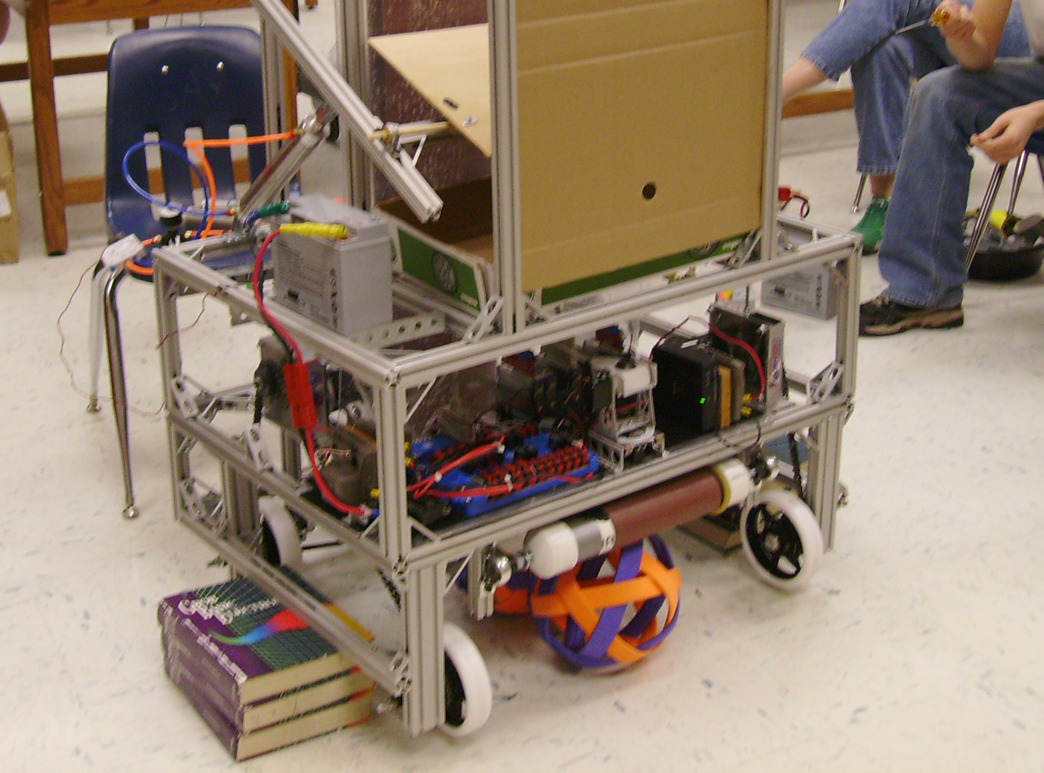

Slide 6
Software Design
Think about the sensors to include in the subsystems
Drivetrain should include the sensors to measure distance, heading and range to target
This allows high level commands to be given to the subsystem
For example, Move forward 2 feet, turn 90 degrees
Object Oriented Design:
Details of the Object implementation are kept within the subsystem

Slide 7
Software Design – Subsystem Requirements
DriveTrain:
Requirements:
Move forward, backward, and rotate
Maximum forward speed: 2 feet/Second (Fast)
Drive in a straight line in autonomous mode
Can turn 90 degrees on command
Can move forward 4 feet on command
Drive with single joystick
Implementation:
Tank Drive : 4 Motors
Sensors: Shaft Encoders and a Gyro

Slide 8
Software Design
Document each subsystem methods and commands
Subsystems
Drive Train – 4 motor
Commands:
Stop, manual drive with joystick
Drive forward until 5 feet from wall
Turn Right 90 degrees, Turn Left 90 degrees
Move forward x feet
Arm/Manipulator
Commands:
Stop, manual drive with left and right buttons
Move to setpoint
Operator Interface
Single Joystick: X and Y axis
3 Buttons: Move arm left, Move arm to Center, Move arm to right

Slide 9
Step 2: Build Robot in RobotBuilder Start and Initialize RobotBuilder Project
A package is a namespace that organizes a set of related classes and interfaces. Conceptually you can think of packages as being similar to different folders on your computer.
Eclipse => WIPLib => Run RobotBuilder
On Creation of new Robot Project, set:
Project Name: e.g.: RobotOne
Team Number: e.g.: 1895
In Robot Project, set:
Java Package: e.g.: “Team1895.RobotOne”
Eclipse Workspace: e.g.: “C:\_Robotics\2016\Eclipse_Projects”
See current workspace: Eclipse => File => Switch Workspace => Other
Wiring File: e.g.: “C:\_Robotics\2016\Eclipse_Projects\RobotOneWires”
Save the RobotBuilder Project file
Select RobotBuilder => Save As => “C:\_Robotics\2016\Eclipse_Projects\RobotOne”

Slide 10
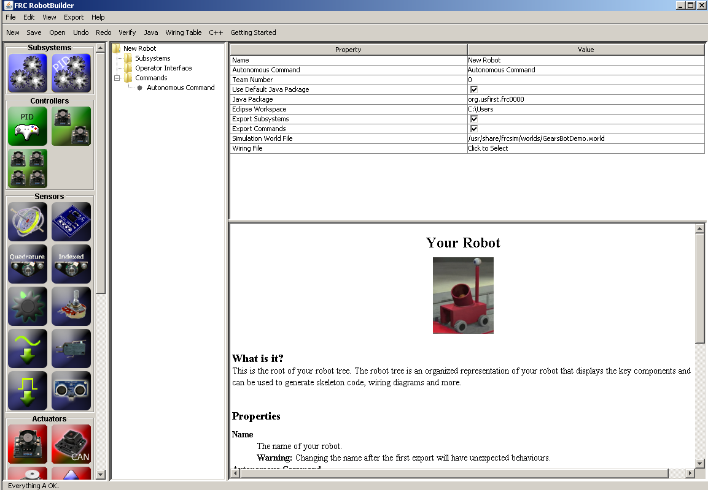
Robot Builder – First startup

Slide 11
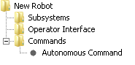
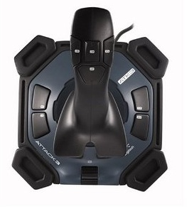
Build Robot in RobotBuilder
Create
Subsystems
Commands for subsystems
Operator Interface
Add a JoyStick
Add a Button on the JoyStick
Associate Buttons with Commands

Slide 12
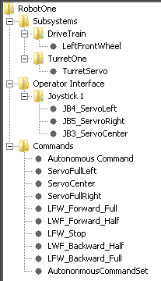
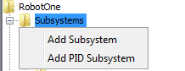
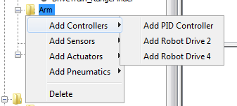
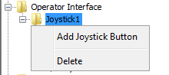
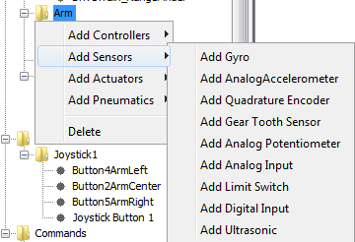
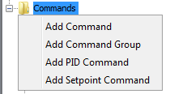
Add subsystems, Joysticks, and sensors by right clicking and selecting

Slide 13
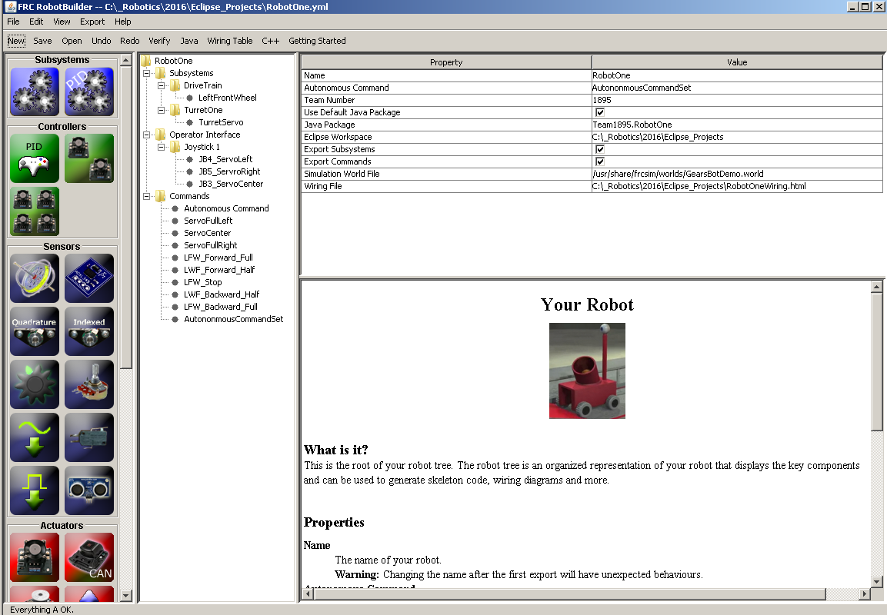

Slide 14
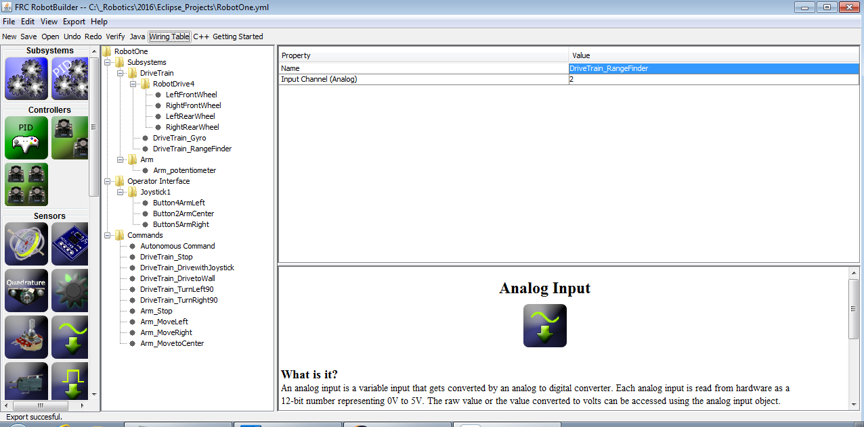

Slide 15
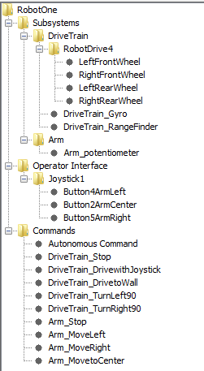
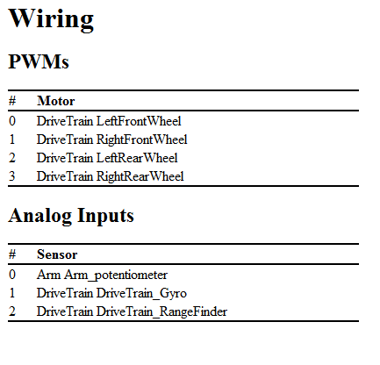
Robot Builder – Explorer and Wiring Diagram

Slide 16
Step 3: Import RobotBuilder into Eclipse
Save the RobotBuilder Project
Select RobotBuilder => Save As => “C:\_Robotics\2016\Eclipse_Projects\RobotOne”
Export the Java Code
Select RobotBuilder => Export => Java Or “Java” on the Menu
Import the Java Project into Eclipse
Select Eclipse => File => Import => General => Existing Projects into Workspace
Browse to project folder: e.g.: “C:\_Robotics\2016\Eclipse_Projects\RobotOne”

Slide 17
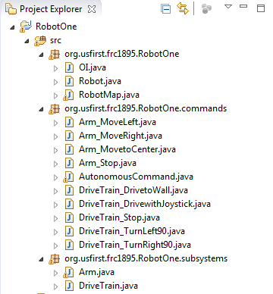
RobotBuilder Project
Resulting JAVA Project in Eclipse
Robot Overhead

Slide 18
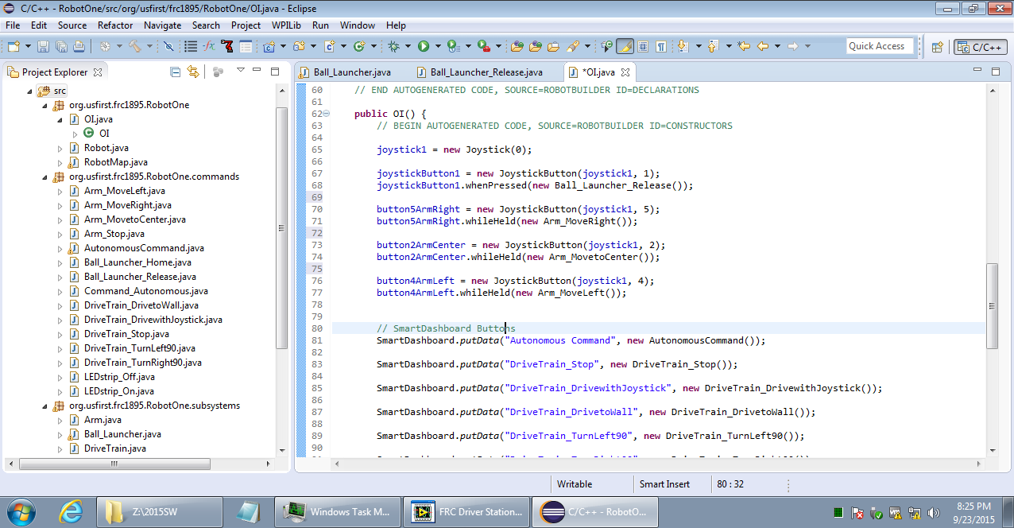

Slide 19
Step 4: Finish the Software in Eclipse Detailed Coding Begins ……….
At this point you have a lot of code that does nothing!
Need to tie inputs to outputs using methods
Need to create Methods() within the Subsystems
Commands call Methods ()
User Interface calls Commands
A “Command” object Tells a “Subsystem” object to do something by way of “Methods”

Slide 20
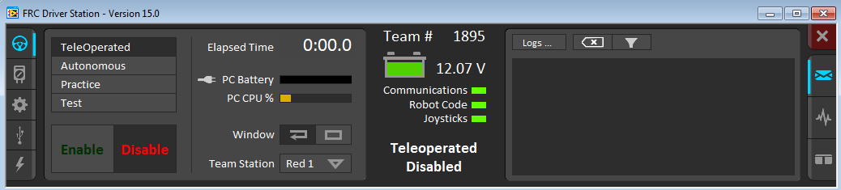
Enter the FRC IterativeRobot Class
RobotBuilder creates an framework or template based on the IterativeRobot
Supports:
Robot software initialization
Autonomous mode
TeleOperate mode
During development, the operating mode is selected by the DriversStation
During Competition, the mode is controlled by the Field Management System

Slide 21
High level structure of the IterativeRobot
Power On
Runs robotInit() method
Initializes all of the defined subsystems (Runs constructors)
Runs OI() method
Initializes the Operator Interface (Runs constructors)
Runs disabledInit() method once
Runs disabledPeriodic() method REPEATEDLY
Runs autonomousInit() method once
autonomousPeriodic() method REPEATEDLY
teleopInit() method once
teleopPeriodic() method REPEATEDLY
Waiting for Go
15 Seconds
2 Minutes

Slide 22

teleopPeriodic() method
Checks for Operator Interface actions
Links the commands to be run
Calls the methods in the subsystem and runs one time
Gets input
Processes
Sets output
Code run in continuous loop for autonomousPeriodic() or teleopPeriodic()
Loop is call 50 times per second (Wow!)

Slide 23
Simple Example of a Control Flow
JoyStick button initiates a command
Command calls a subsystem method
Subsystem method signals a motor controller
Motor controller makes the wheels turn or an arm move!

Slide 24
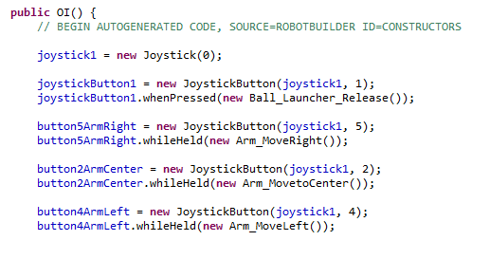
Simple Example – Operator Interface Calls the Command
When Button 2 is pushed, the command to Move the Arm is run

Slide 25
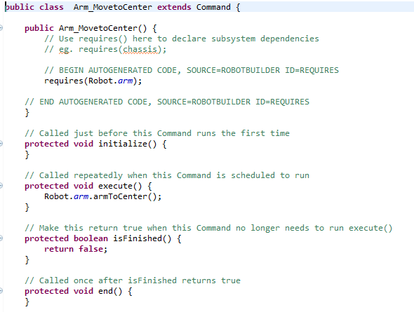
Simple Example – Commands Calls the Subsystem Method
Commands call Subsystem Methods

Slide 26
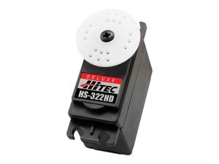
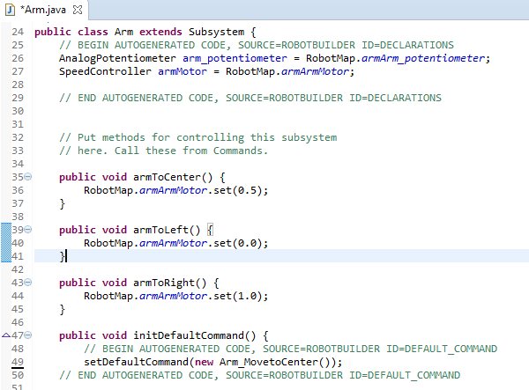
Simple Example –Subsystem Method controls Hardware
.Set(0.5) [Mid point]
.Set(0.0)
[Full Counter
Clockwise]
.set(1.0)
[Full clockwise]
Methods Control the hardware with primitive commands

Slide 27
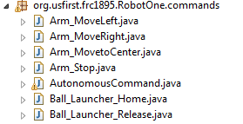
Commands
The Command based approach provides a great deal of flexibility
When a command is called you can call methods:
Call a subsystem method one time at the beginning
Repeatedly
Call a subsystem method one time at the end of a command

Slide 28
Options for Commands
public class Arm_MovetoCenter extends Command {
// Class Constructor
public Arm_MovetoCenter() {
requires(Robot.arm);
}
// Called just before this Command runs the first time
protected void initialize() {
}
// Called repeatedly (50 times per second) when this Command is scheduled to run
protected void execute() {
}
// Make this return true when this Command no longer needs to run execute()
protected boolean isFinished() {
return false;
}
// Called once after isFinished returns true
protected void end() {
}
// Called when another command which requires one or more of the same
// subsystems is scheduled to run
protected void interrupted() {
}
}

Slide 29
Default Command
The command performed when no other commands are given to a subsystem
Each subsystem may, but is not required to, have a default command which is scheduled whenever the subsystem is idle
The most common example of a default command is a command for the drivetrain that implements the normal joystick control.

Slide 30
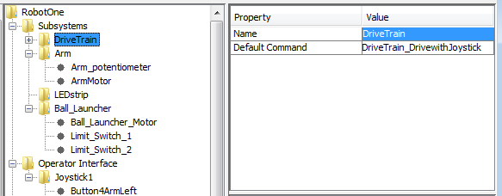
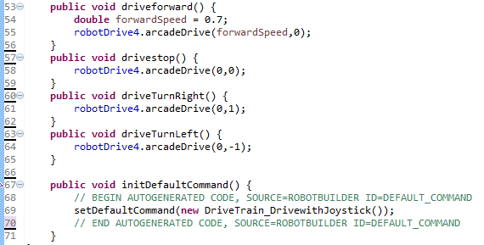
Default Command

Slide 31
Autonomous Command
Create an Autonomous Command Group
Tells the Robot what to do when in Autonomous Mode
Consists of a sequence of other command
Performed in series or parallel
Start of Autonomous
Move Forward
4 feet
Turn Right 90 degrees
Move to exactly 6 feet from Target
Shoot Ball
Raise Arm
Notice how these actions are performed in parallel

Slide 32
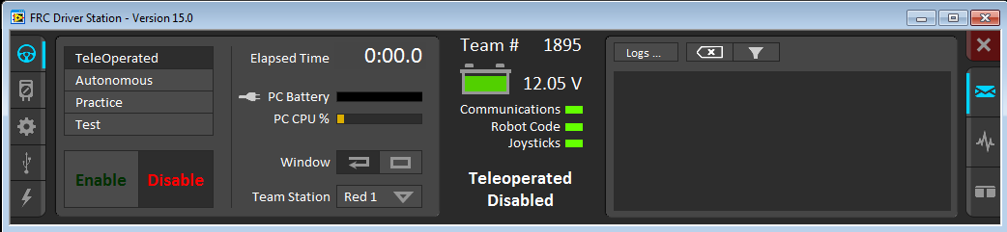
Go!
Compile => Deploy => Execute

Slide 33
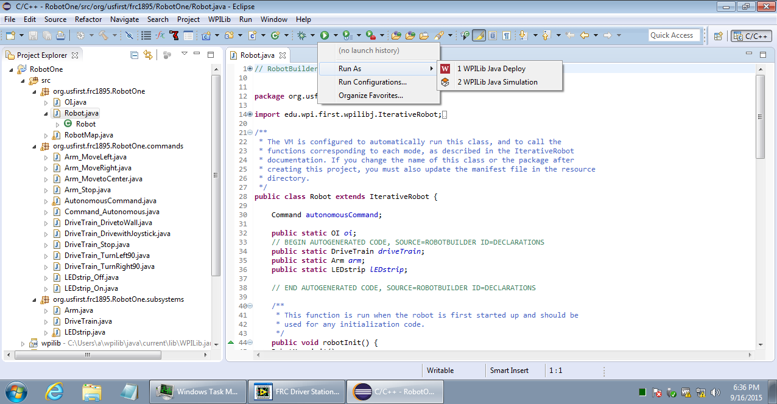
Compile and Deploy

Slide 34
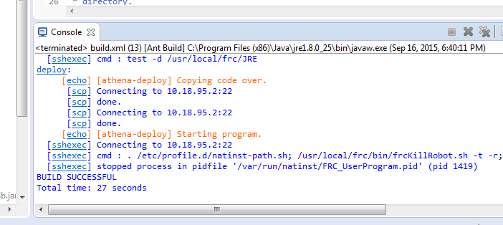
Console Display of Successful Deployment

Slide 35
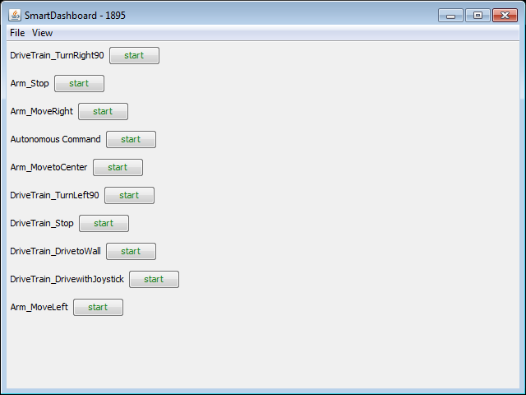
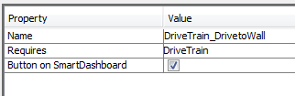
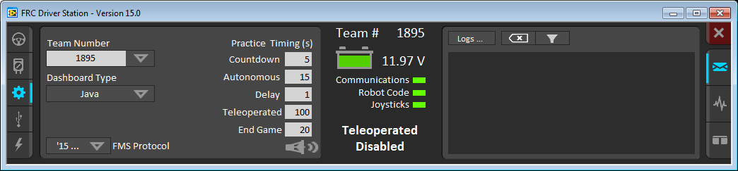
Smart Dashboard

Slide 36
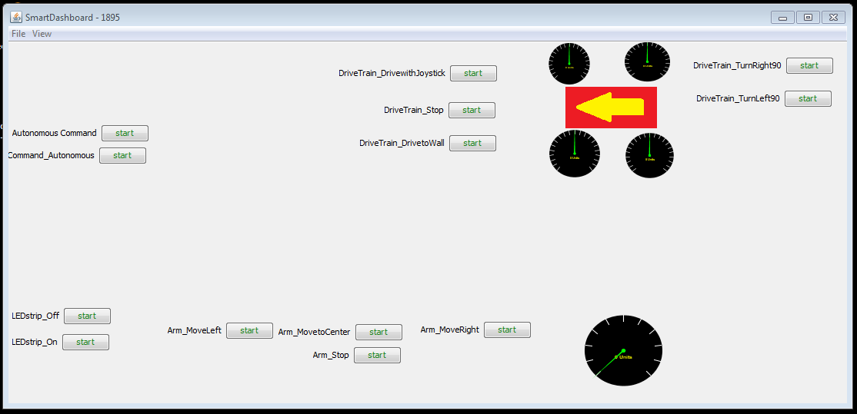
Start the Smart Dashboard

Slide 37
Initial Checkout!
Think Safety!
Lift Robot wheels off of ground to prevent sudden unplanned movement
Keep hands, fingers and hair away from Robot
Test one function at a time
Observe and think
Take Notes
Our Robots may not follow "Asimov's Three Laws of Robotics"
“1) A robot may not injure a human being …”

Slide 38
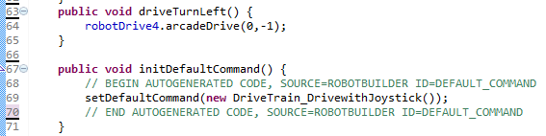
Updating the Code to Solve Problems
Code update can be performed either in Eclipse or RobotBuilder
In Eclipse, edit code directly. Always add comments
In RobotBuilder:
Re-Open RobotBuilder, Make the required updates, then export
In Eclipse, Refresh the project by selecting “F5”
The robotBuilder updates will be shown, User provided code remains
Don’t edit code between the RobotBuilder comments

Slide 39
Step 5: Test, Troubleshoot, Resolve Iterative Process…
Test
Resolve
Troubleshoot

Slide 40
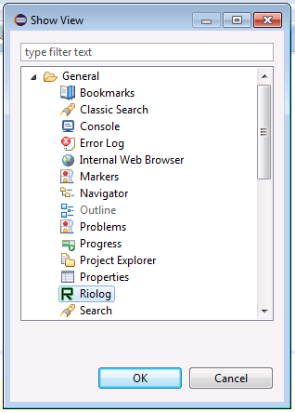
Troubleshooting Methods:
1) Print statements to the System Console (Riolog)
System.out.println("Ball Release Going Out");
Smart Dashboard
Many other approaches …
Console

Slide 41
FRCSIM (a WPI Implementation of Gazebo Robot Simulator)
FRCSIM provides a means to develop software and run in a Simulator
High Level Process:
Create Robot in SolidWorks
Enhance with motors and sensors with the FRC SolidWorks Gazebo Plugin
Export Robot and World
Open robot and world Gazebo
Develop and Run code in Eclipse

Slide 42
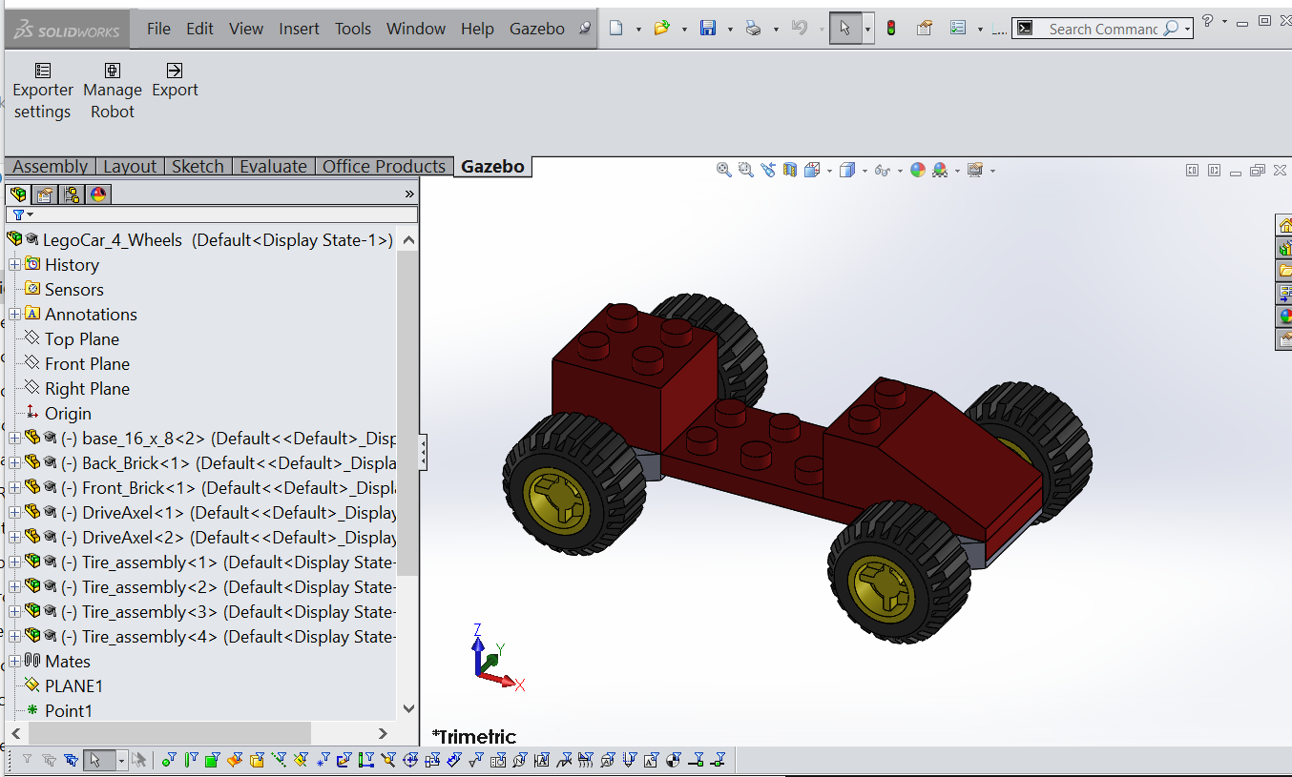
1) Create Robot in SolidWorks

Slide 43
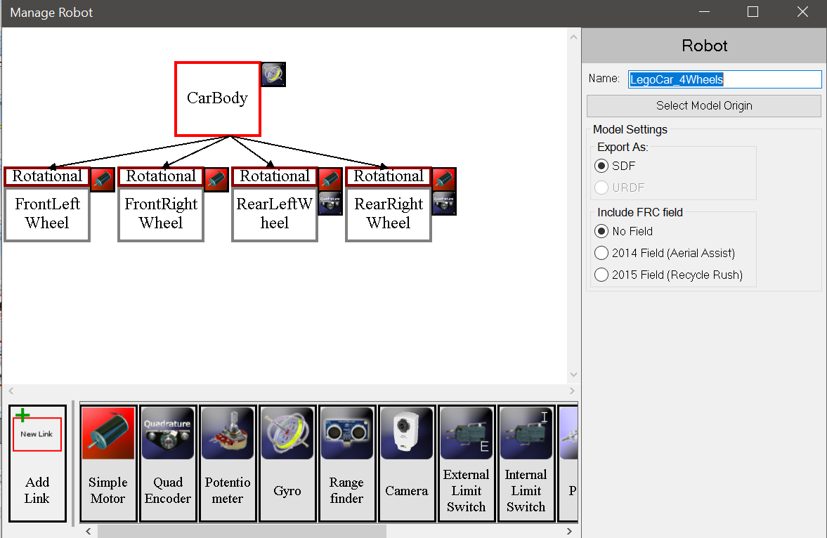
2) Enhance with motors and sensors with SolidWork’s Gazebo Plugin

Slide 44
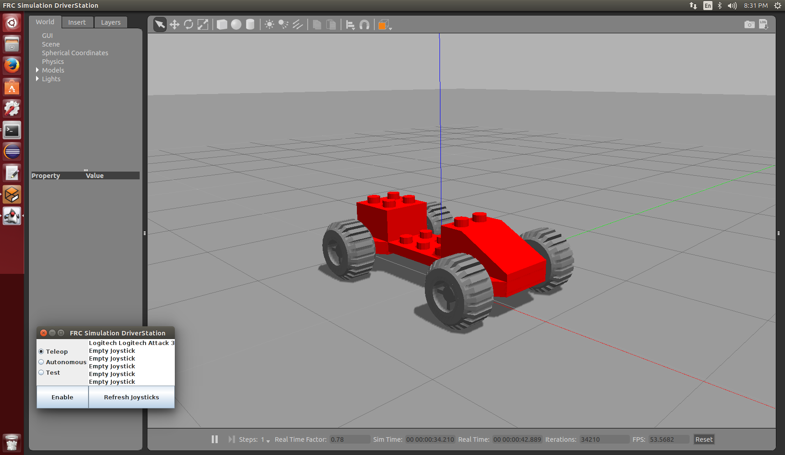
4) Open the Robot Model in Gazebo

Slide 45
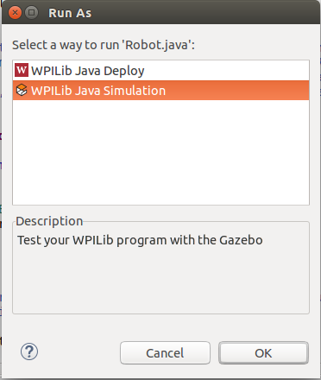
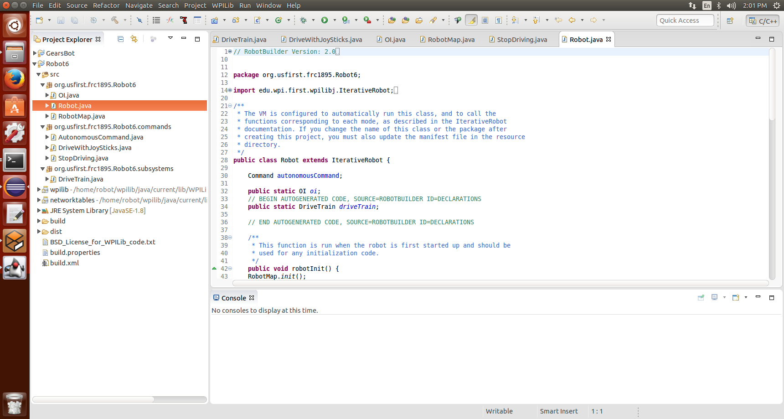
5) Develop and Run code in Eclipse

Slide 46
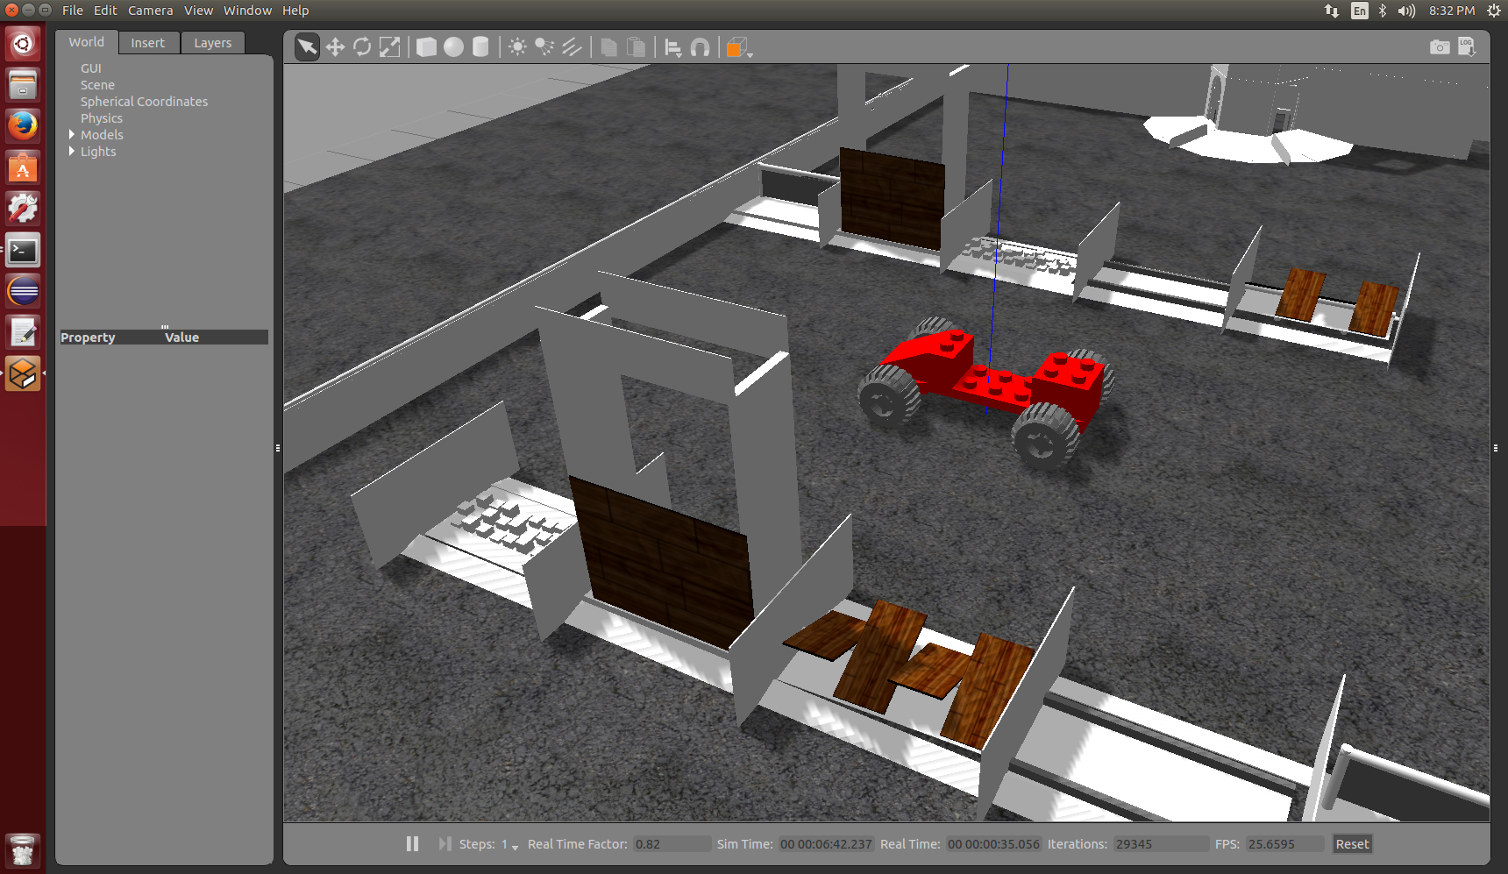
6) Running the Simulation

Slide 47
Questions?

Slide 48
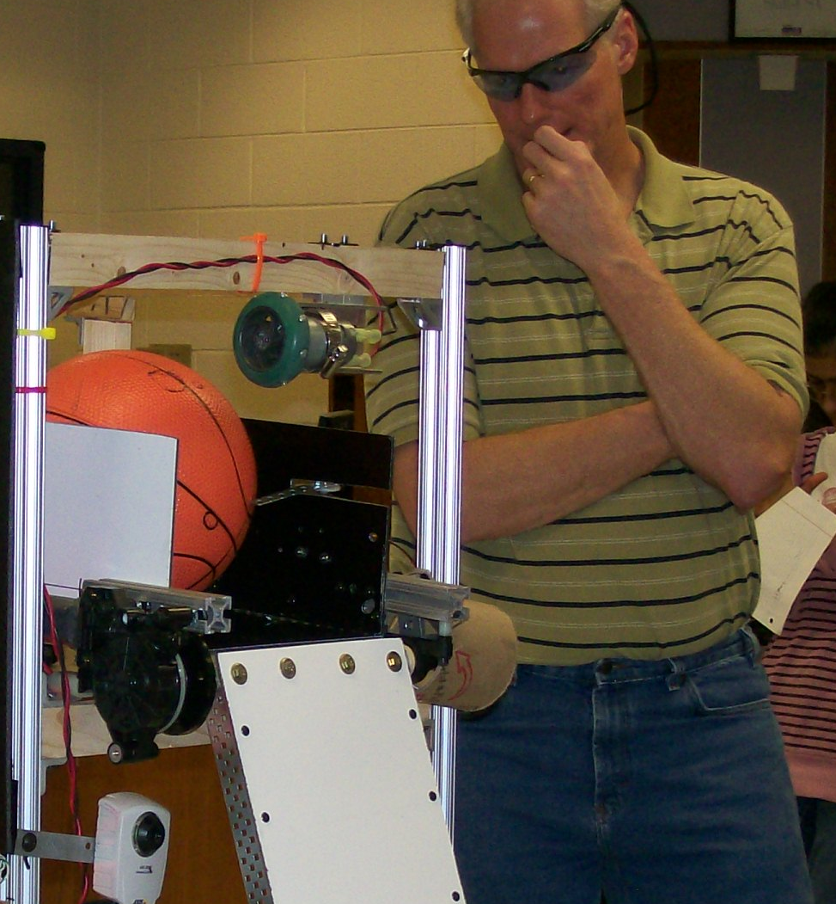

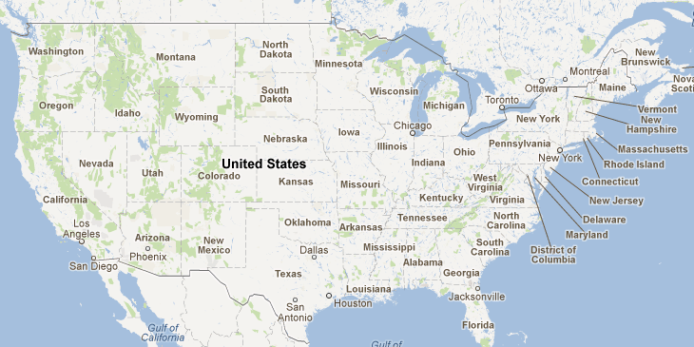
Manassas, VA
Osbourn High school

Slide 49
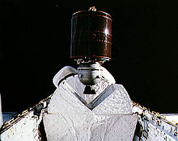

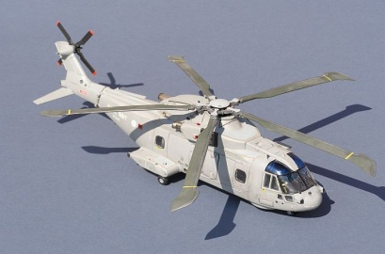

My career: BS - Electrical Engineering (Univ. of South Carolina, 1983)
Commercial Satellite Communications
Military Communications (Robust HF Radios)
Military Communications Maintenance Training Simulators
Military Flight Simulators (Helicopters)
Military Communications on Helicopters
Military Electronic Communication Systems (Secure Email)
Roles:
System Engineering – Figuring out what needs to be made
Integration and Test - Making new systems work the first time
Information Assurance – Protecting our systems

Slide 50
Resources
Guidance
https://wpilib.screenstepslive.com/s/4485
WPI Library
http://first.wpi.edu/FRC/roborio/stable/docs/java
http://first.wpi.edu/FRC/roborio/stable/docs/java/classedu_1_1wpi_1_1first_1_1wpilibj_1_1command_1_1WaitCommand.html
Eclipse:
http://help.eclipse.org/luna/index.jsp?topic=%2Forg.eclipse.cdt.doc.user%2Ftasks%2Fcdt_t_comment_out.htm
FRC Roborio eclipse plugins zip file
http://first.wpi.edu/FRC/roborio/zipfile/
WPI ThinkTank
http://thinktank.wpi.edu/Portal
FRCSIM Resources:
https://wpilib.screenstepslive.com/s/4485/m/23353
http://first.wpi.edu/FRC/roborio/release/simulation/

